Slide 1

The concept of a data structure, such as a stack, can be understood independently of the element type it manipulates.
Generic classes provide a means for describing the concept of a stack (or any other class) in a type-independent manner.
These classes are known as parameterized classes or parameterized types because they accept one or more type parameters.
© Copyright 1992-2015 by Pearson Education, Inc. All Rights Reserved.

Slide 2
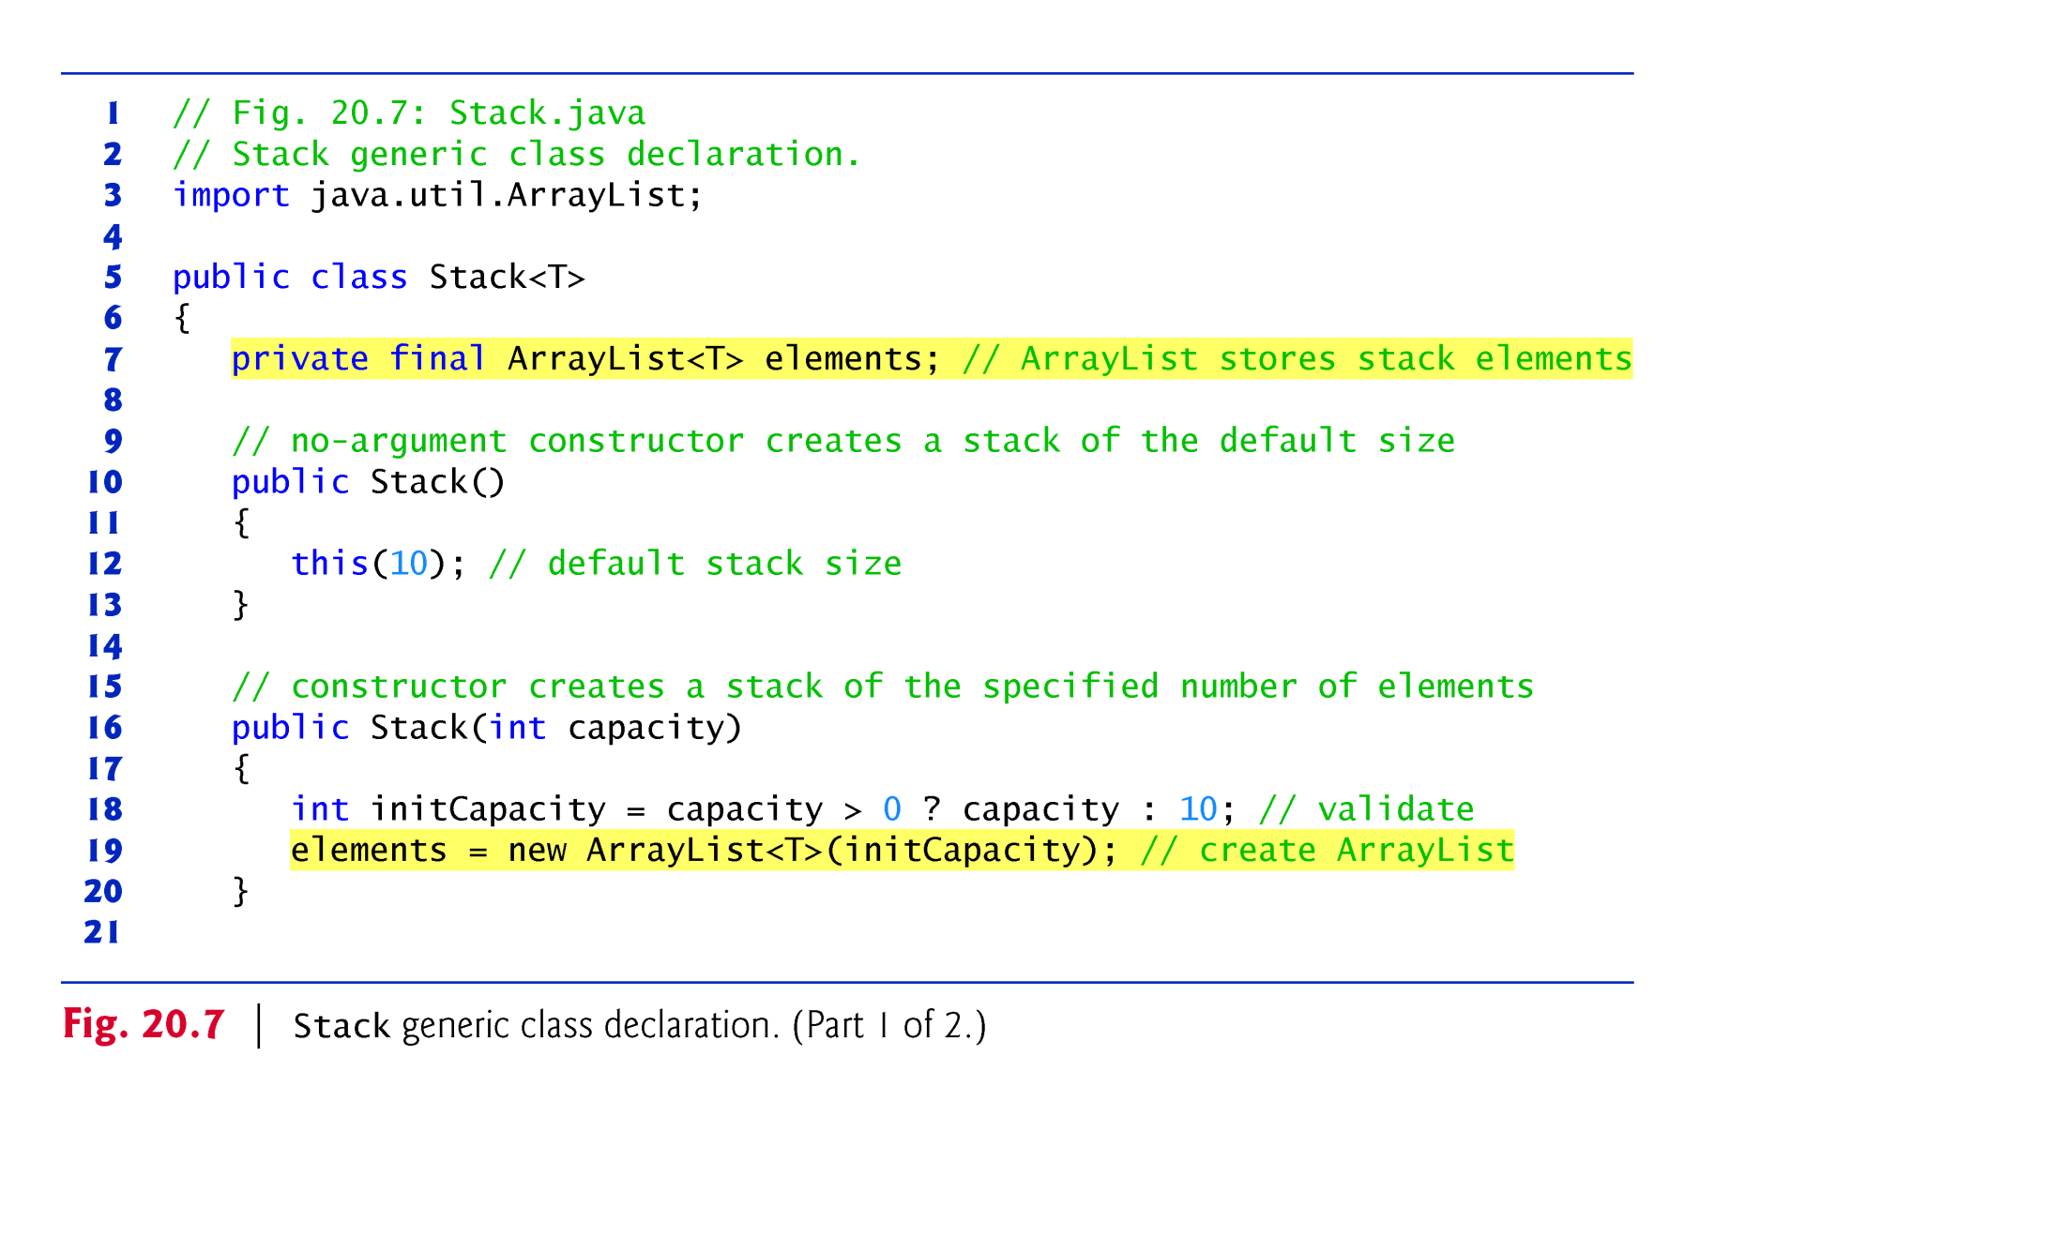
© Copyright 1992-2015 by Pearson Education, Inc. All Rights Reserved.

Slide 3
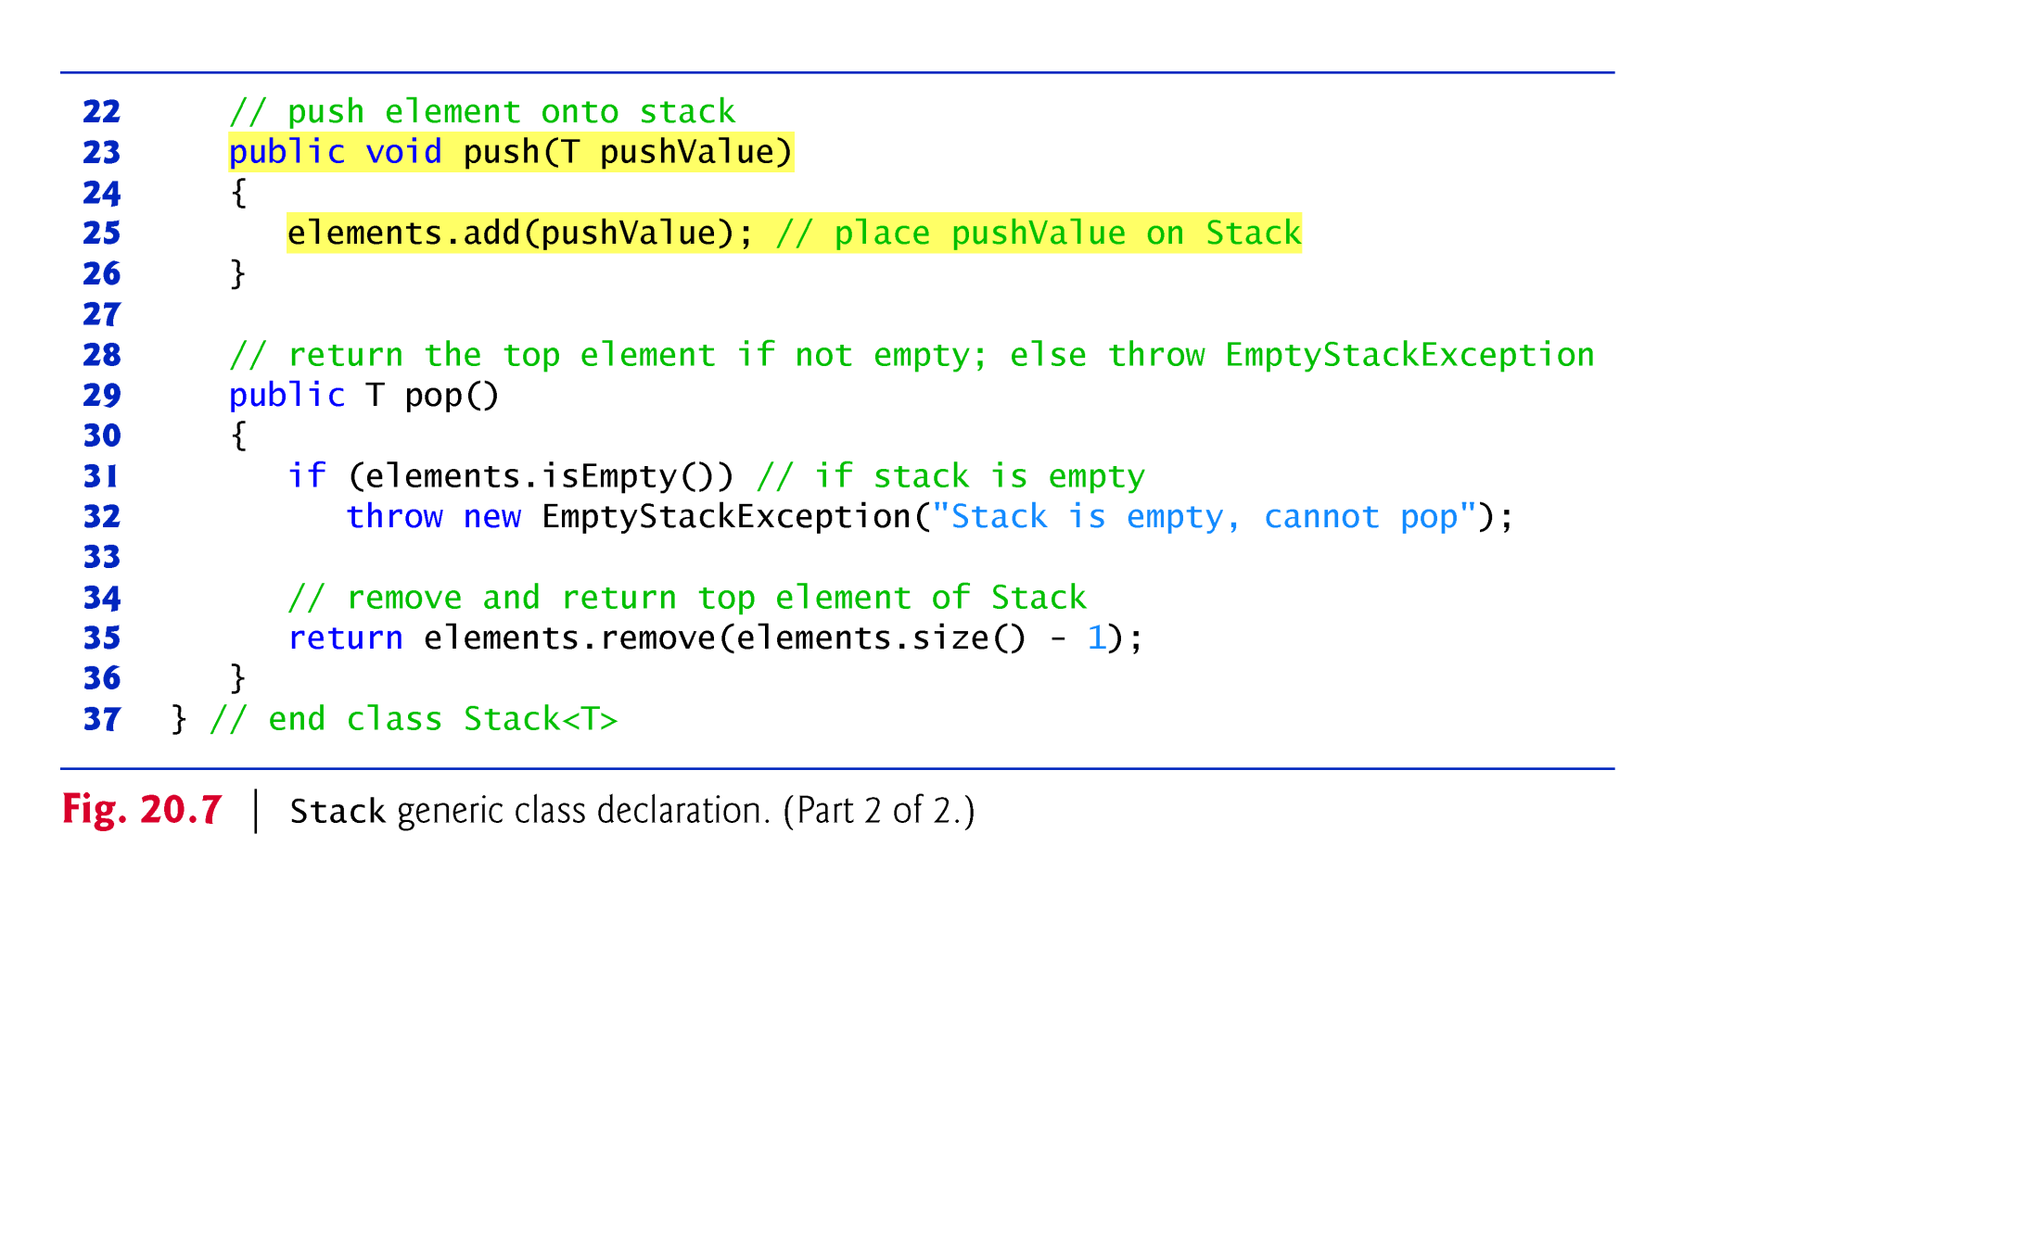
© Copyright 1992-2015 by Pearson Education, Inc. All Rights Reserved.

Slide 4
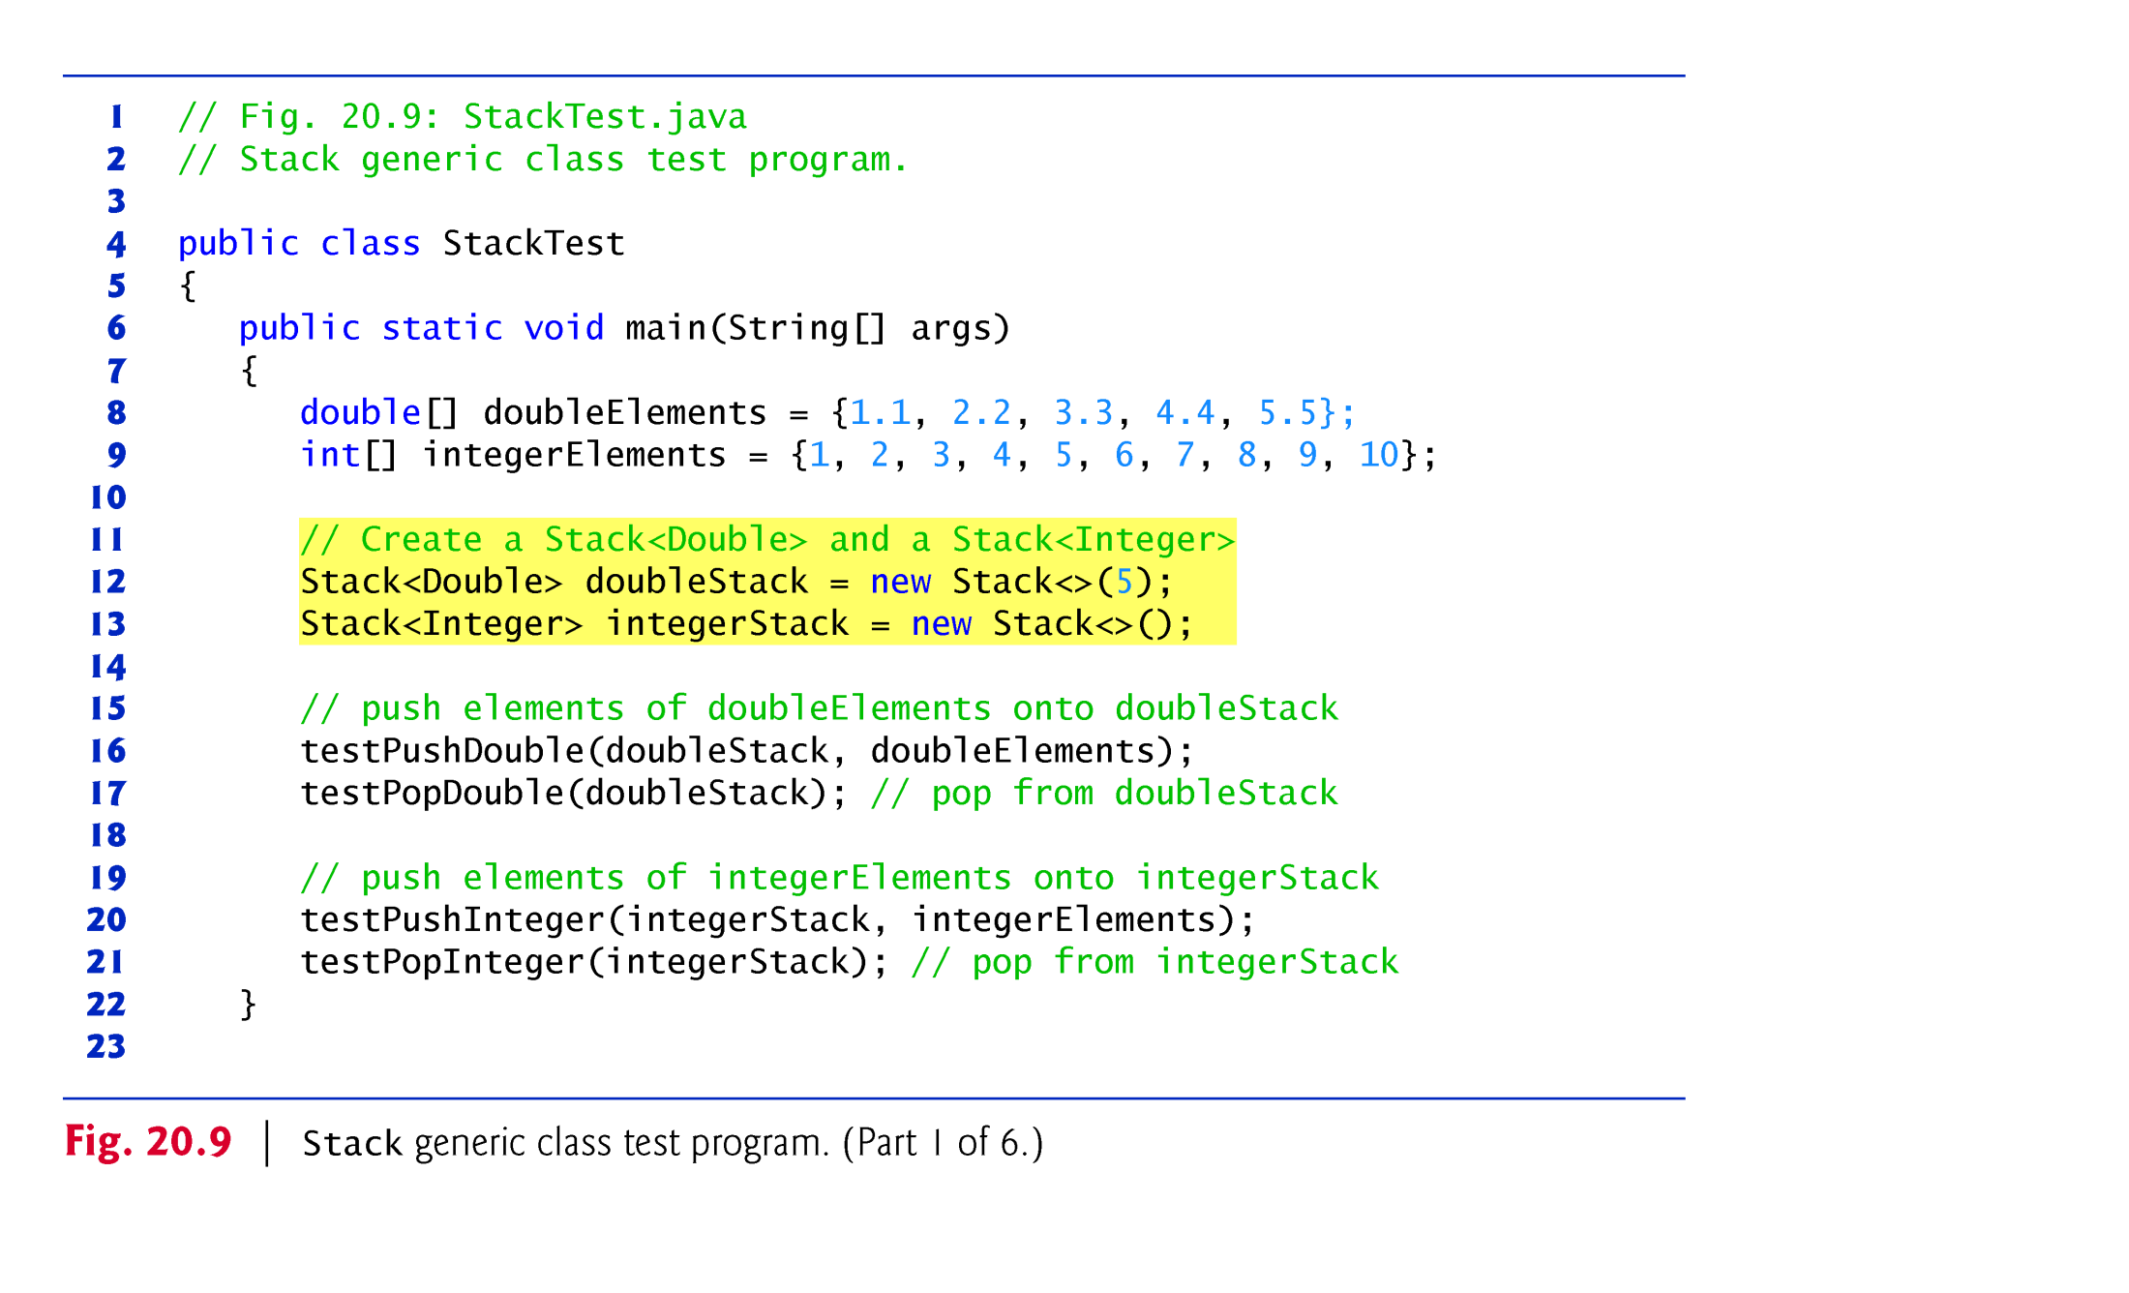
© Copyright 1992-2015 by Pearson Education, Inc. All Rights Reserved.

Slide 5
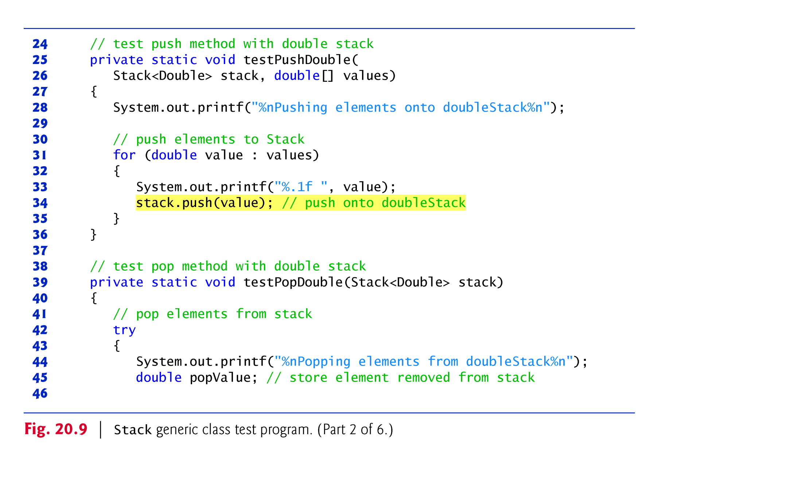
© Copyright 1992-2015 by Pearson Education, Inc. All Rights Reserved.

Slide 6
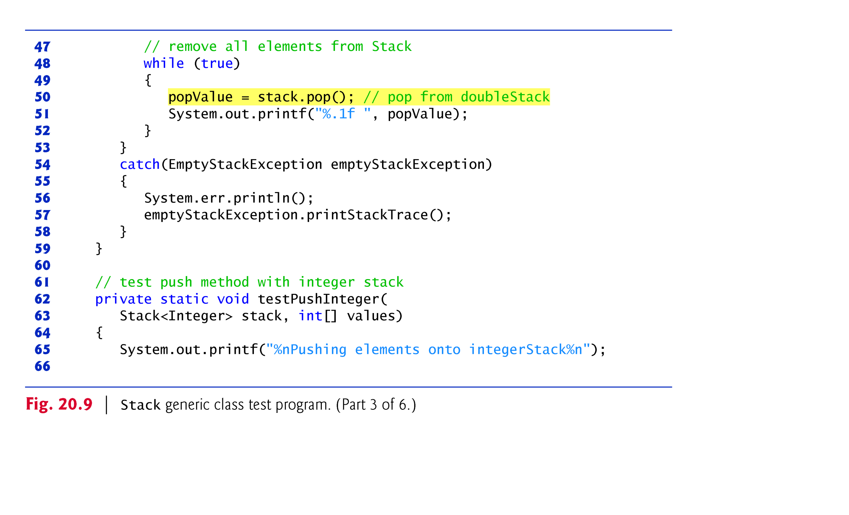
© Copyright 1992-2015 by Pearson Education, Inc. All Rights Reserved.

Slide 7
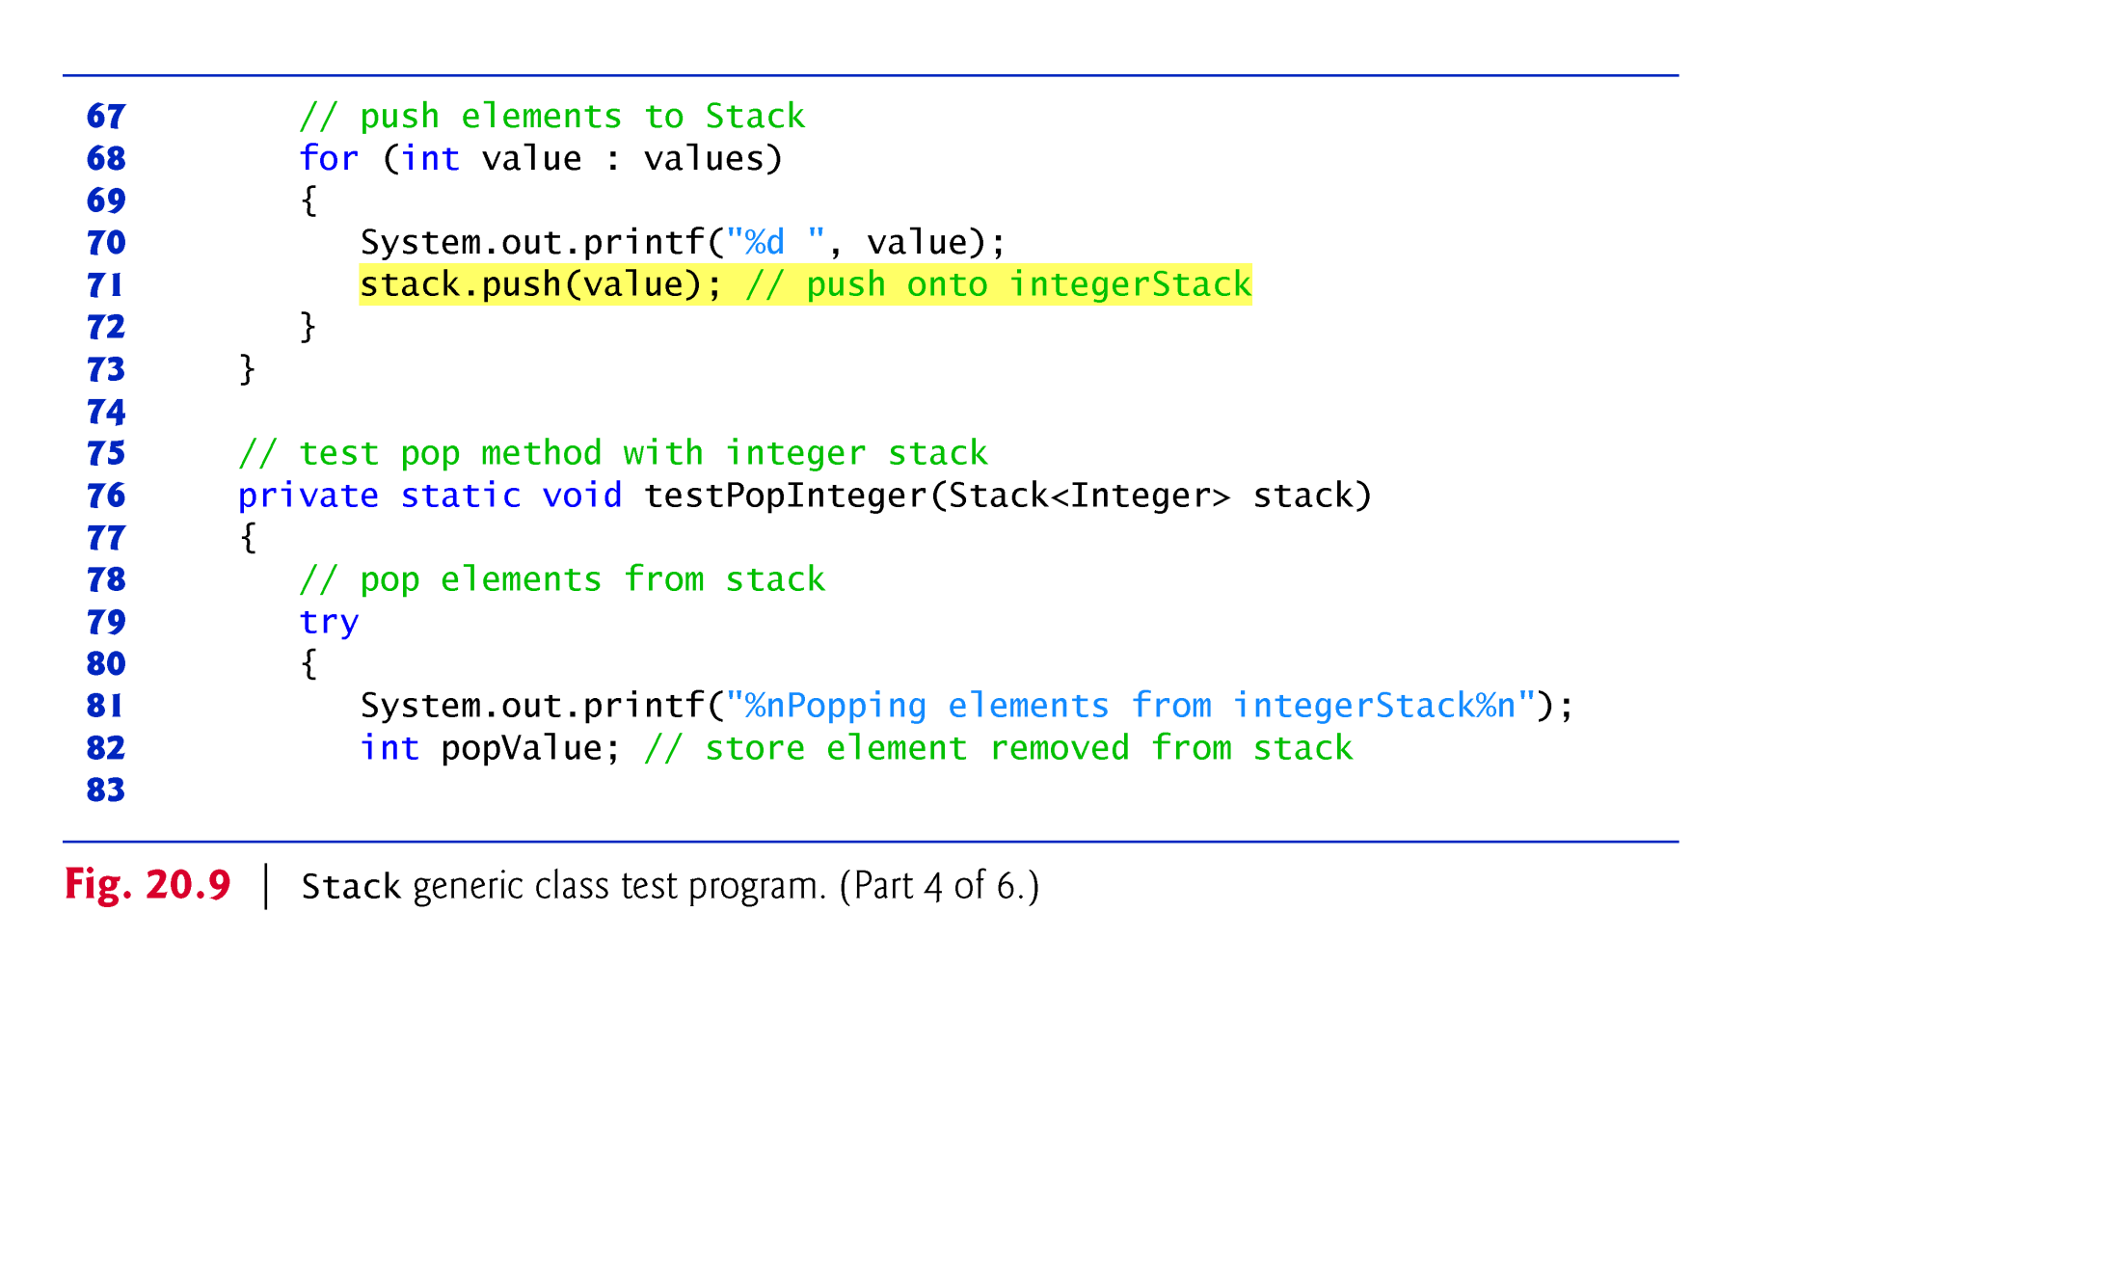
© Copyright 1992-2015 by Pearson Education, Inc. All Rights Reserved.

Slide 8
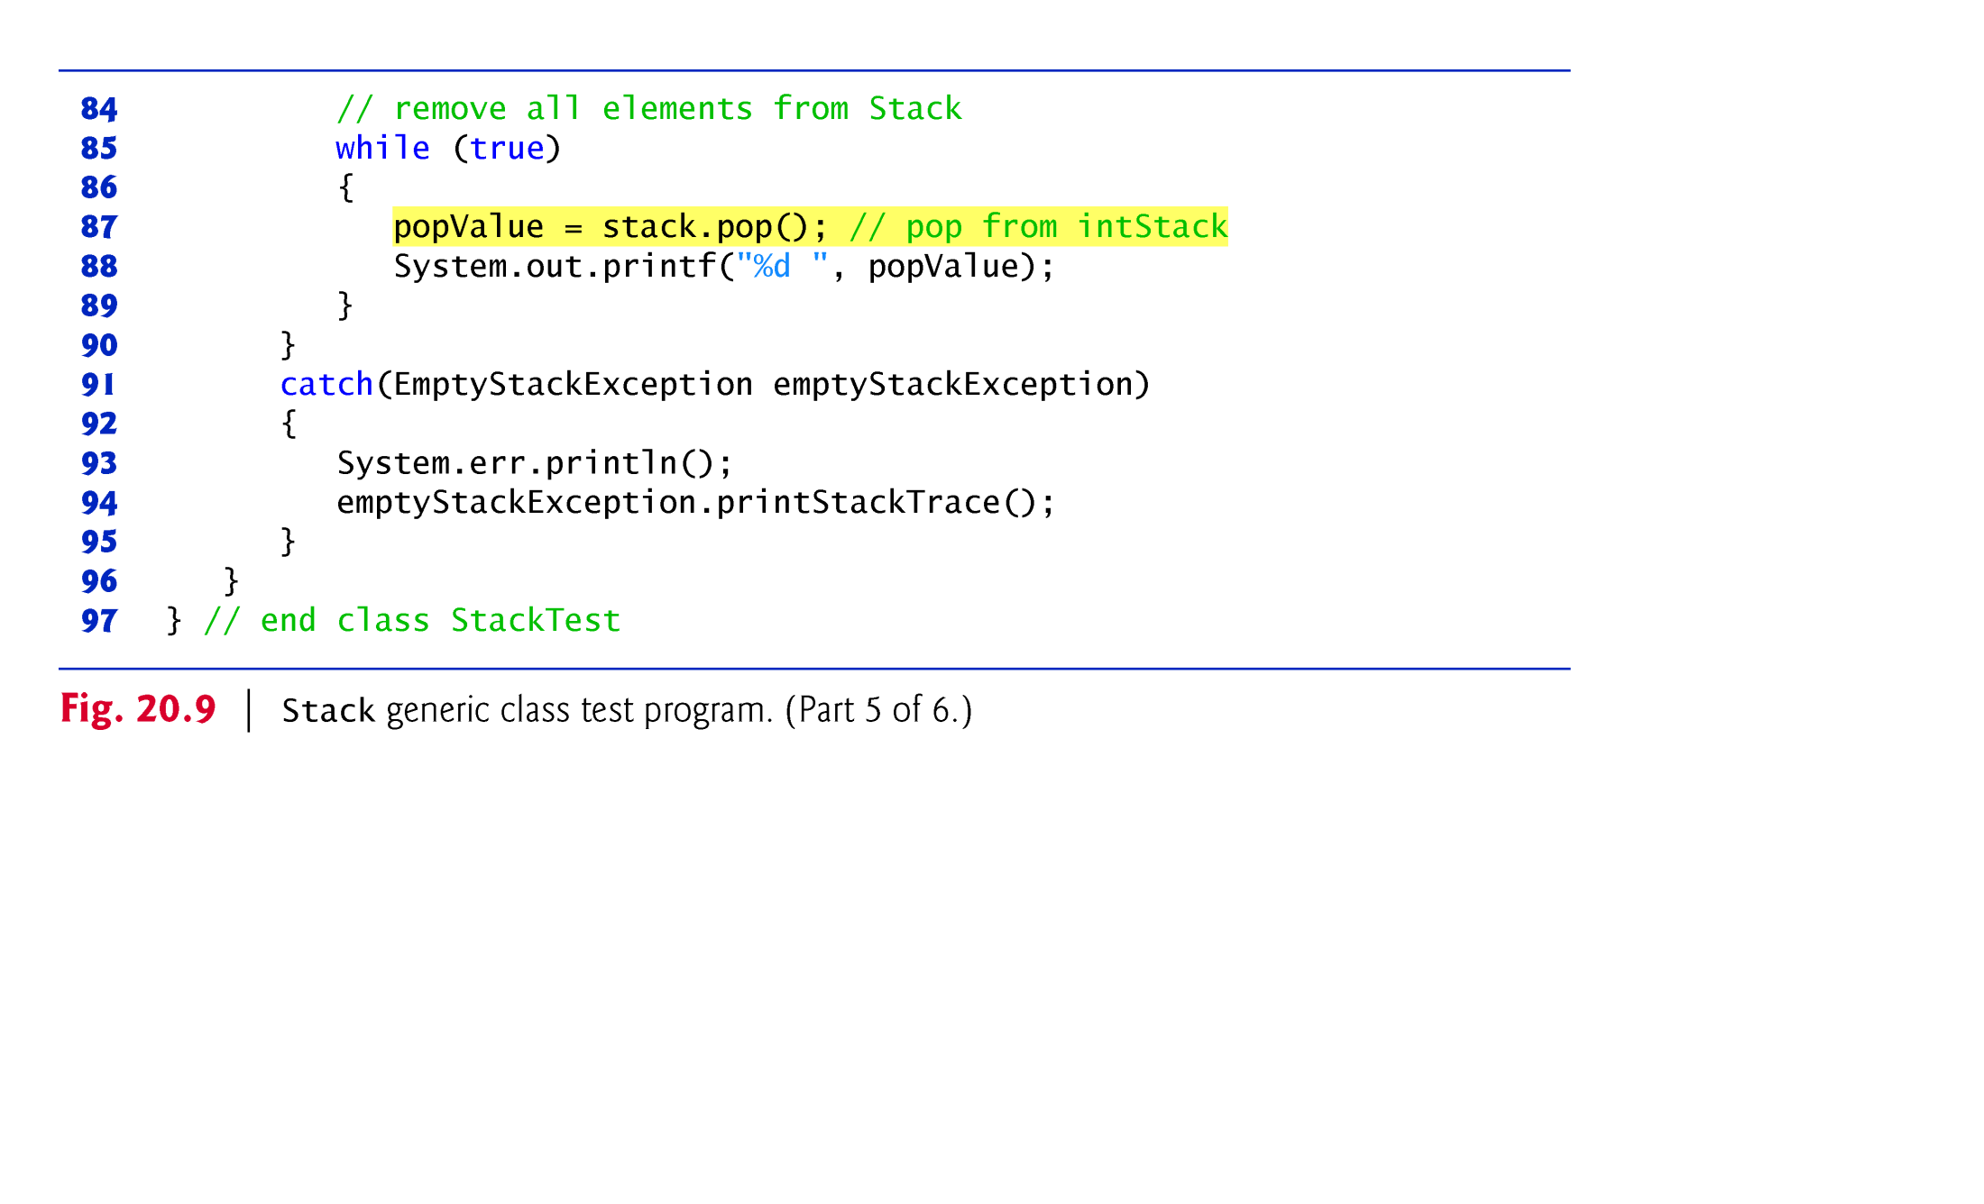
© Copyright 1992-2015 by Pearson Education, Inc. All Rights Reserved.

Slide 9
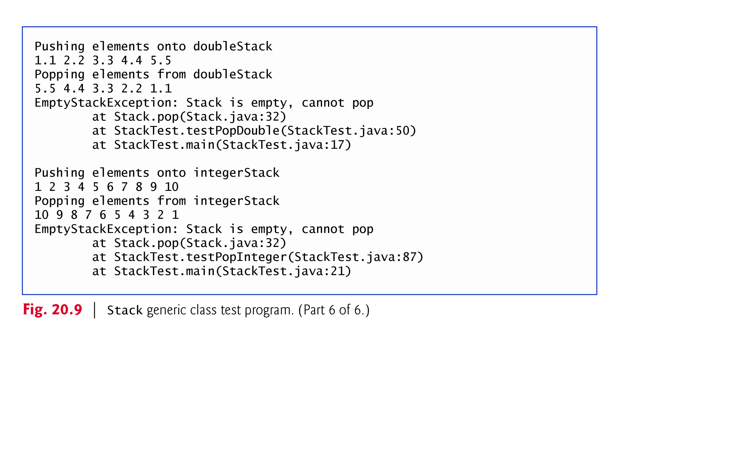
© Copyright 1992-2015 by Pearson Education, Inc. All Rights Reserved.

Slide 10

The code in methods testPushDouble and testPushInteger from the previous example is almost identical for pushing values onto a Stack<Double> or a Stack<Integer>, respectively, and the code in methods testPopDouble and testPopInteger is almost identical for popping values from a Stack<Double> or a Stack<Integer>, respectively.
This presents another opportunity to use generic methods.
© Copyright 1992-2015 by Pearson Education, Inc. All Rights Reserved.

Slide 11
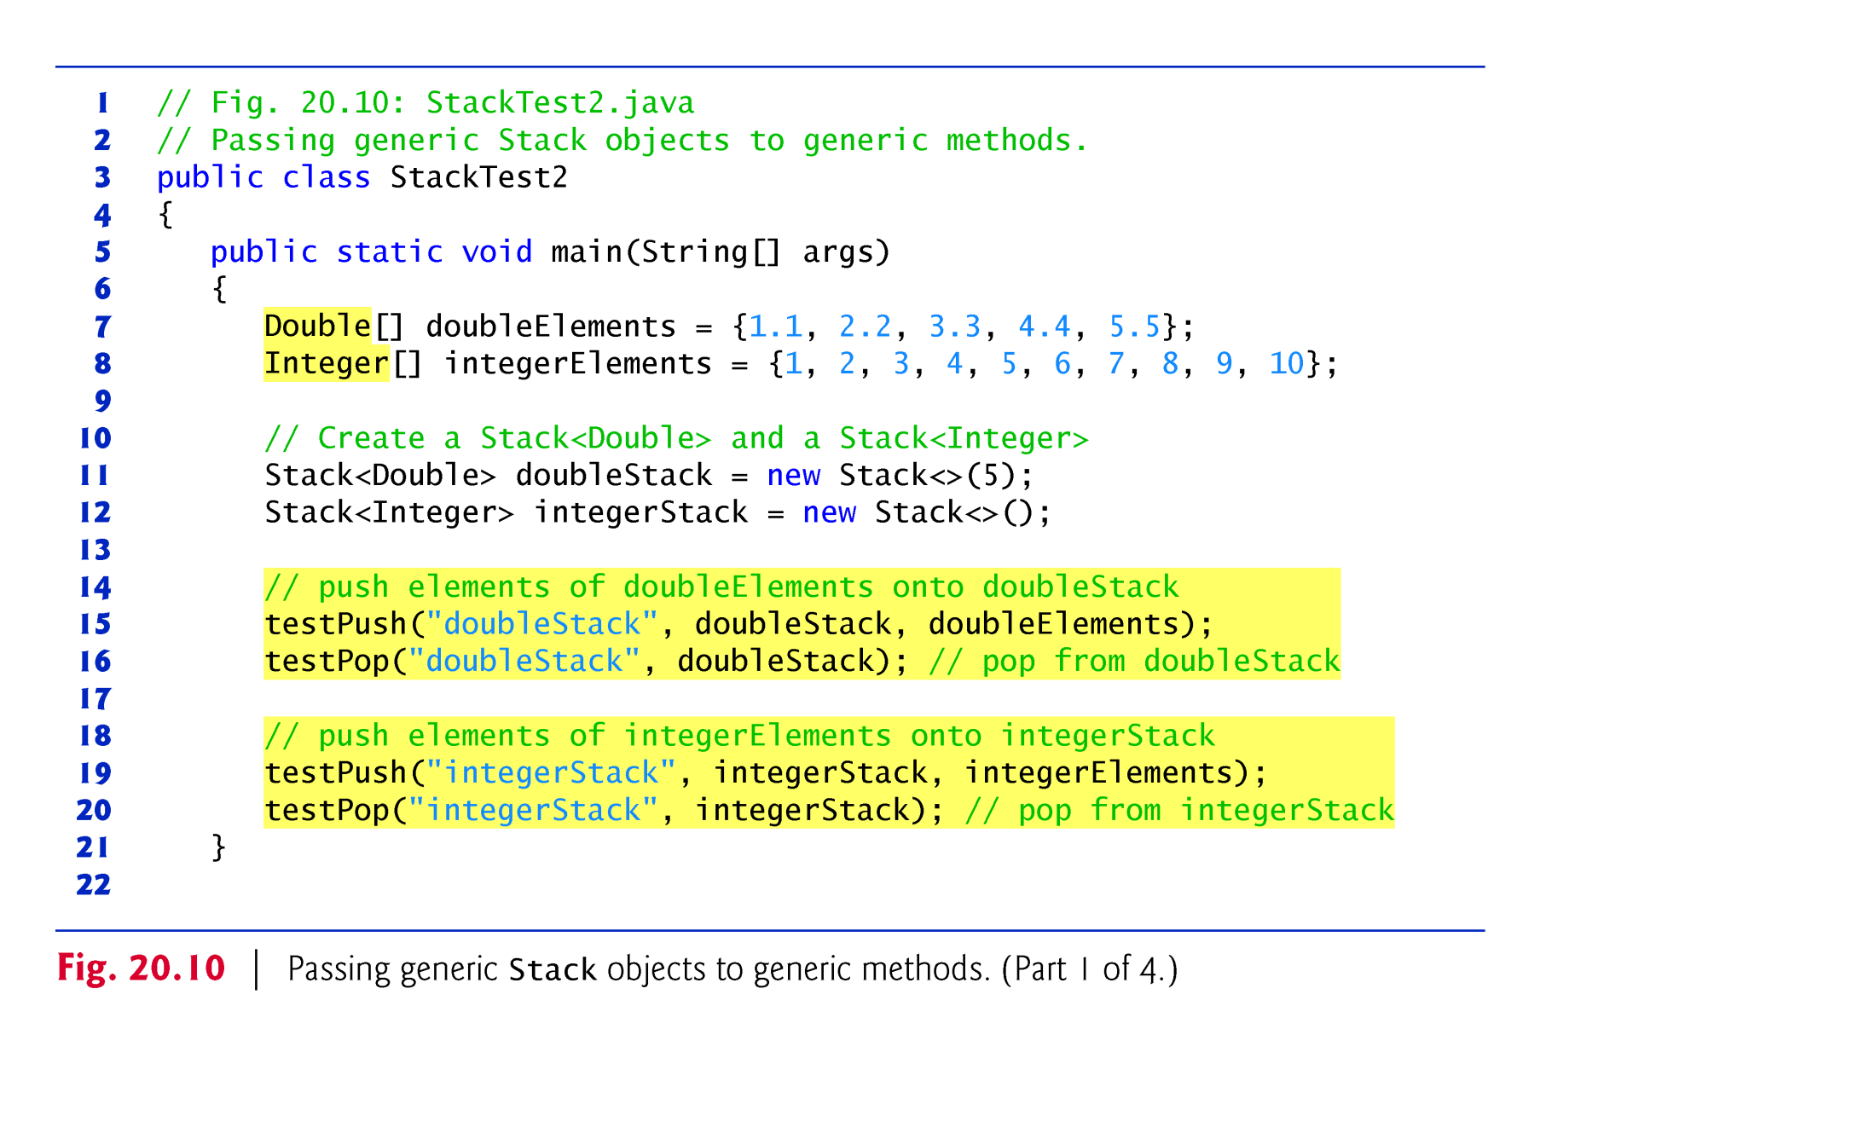
© Copyright 1992-2015 by Pearson Education, Inc. All Rights Reserved.

Slide 12
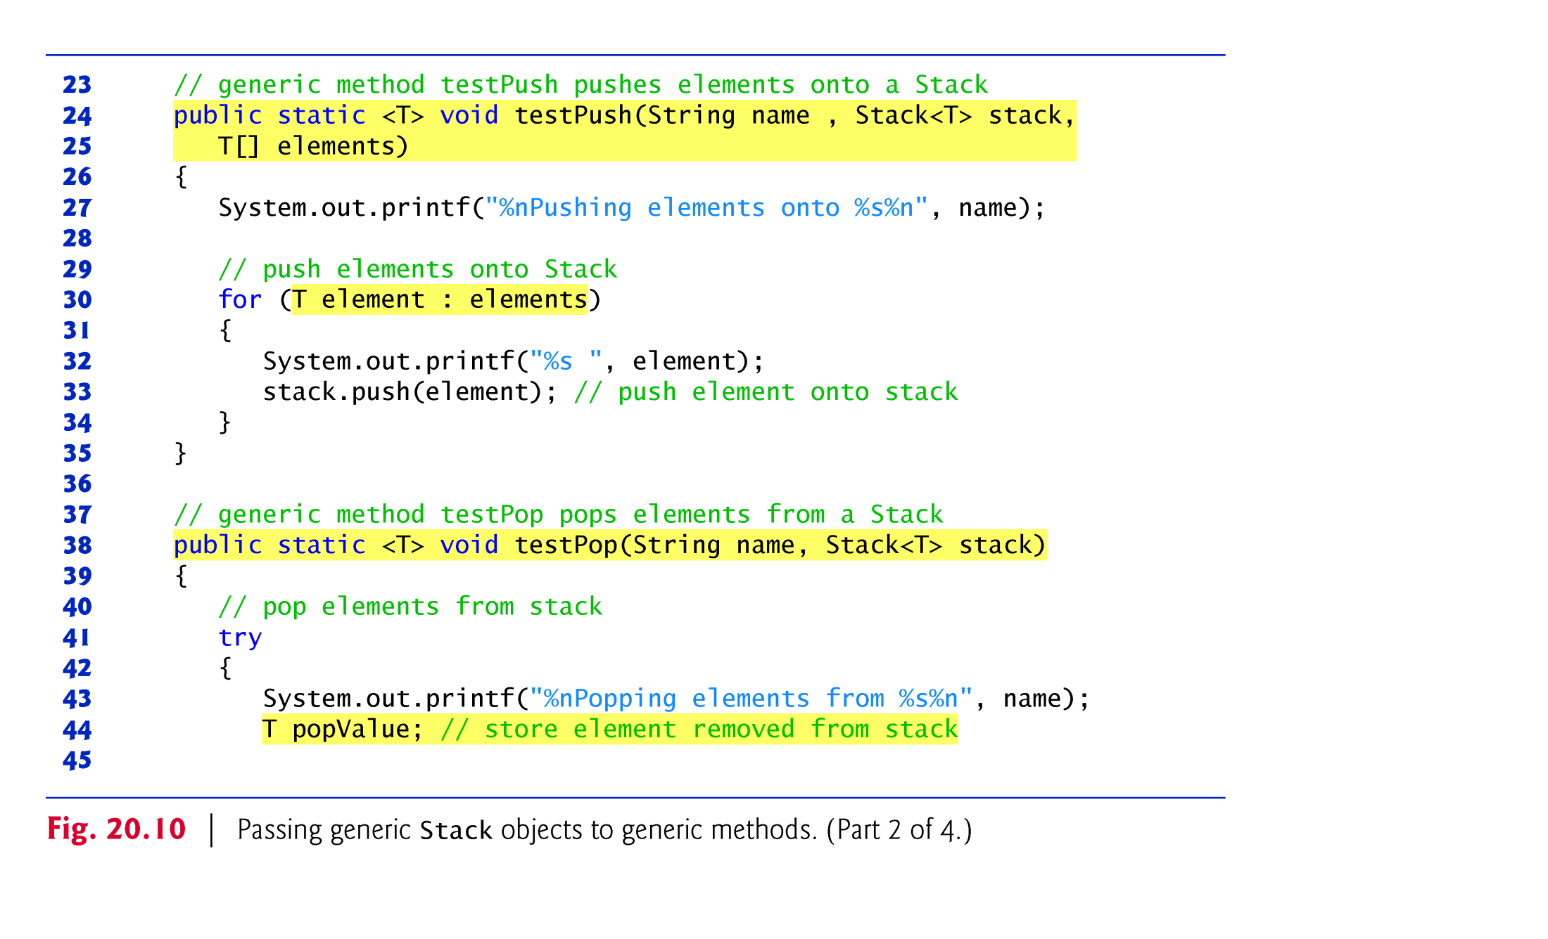
© Copyright 1992-2015 by Pearson Education, Inc. All Rights Reserved.

Slide 13
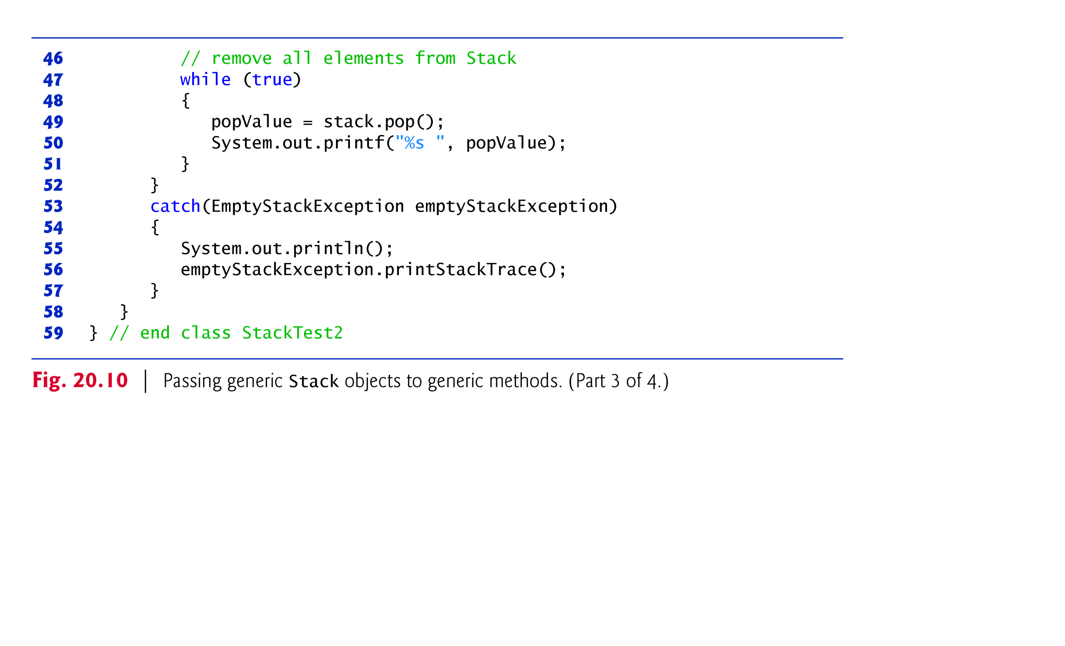
© Copyright 1992-2015 by Pearson Education, Inc. All Rights Reserved.

Slide 14
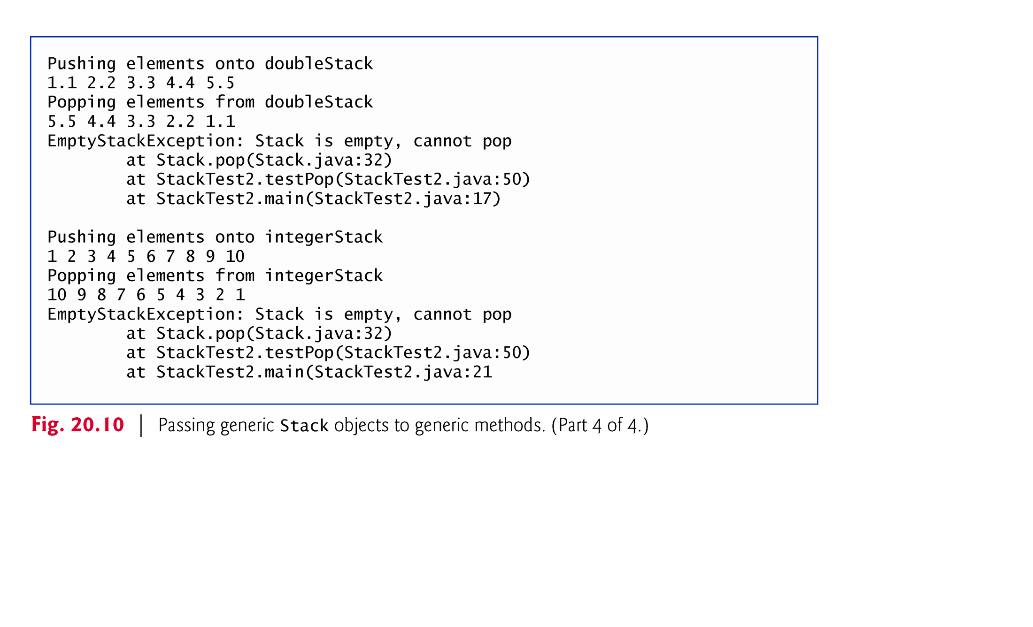
© Copyright 1992-2015 by Pearson Education, Inc. All Rights Reserved.

